Slide 1

Credit card fraud detection using anomaly detection techniques
Presented by
VAIBHAVI PATIL
(1BM19CS217)
Under the guidance of
Dr. Rajeshwari B S
Assistant professor
Department of Computer Science and Engineering
BMS College and Engineering, Bengaluru

Slide 2
Outline
Introduction
1.1. Overview
1.2. Motivation
1.3. Objectives
2. Literature Survey
3. Methodology/Techniques or Algorithms used.
4. Tools used
5. Modules implementation and results.
5.1. Module 1 (Description with diagrams where ever required and results)
5.2. Module 2 (Description with diagrams where ever required and results)
References

Slide 3
Introduction
1.1 Overview
Credit card transactions are to be carefully monitored for the detection of fraudulent credit card transactions taking place.
Anomaly detection techniques can be used for monitoring all those transactions which deviate from a certain criteria and can be classified as fraud transactions.
Anomaly Detection is the technique of identifying rare events or observations which can raise suspicions by being statistically different from the rest of the observations. Such “anomalous” behavior typically translates to some kind of a problem like a credit card fraud, failing machine in a server, a cyber attack, etc.
In the work done here we discuss the different anomaly detection machine learning models and interpret the model.

Slide 4
1.2 Motivation
In this era there are roughly 1 billion credit card transactions taking place which are either online or offline.
The credit card number is sufficient for the online transactions.
With this increasing convenience of transactions there is risk associated with it.
Over 42% of the population has experienced credit card fraud in India.
There is a necessity to come up with solutions to allow these fraudulent transactions from happening in the future.
We can make use of the data that organizations collect of the transactions happening which are both genuine and fraud and identify the patterns the fraudulent transactions follow.
For this purpose several machine learning algorithms can be used and a few are discussed here.

Slide 5
1.3 Objectives
Take a more trustworthy source, for double-checking the data, at least to train the model.
Take a dataset which is not skewed to train the model.
The algorithm which is being used must be fast enough to detect the anomaly and distinguish it as a fraud, instantly.
Higher accuracy of fraud detection.
Less manual work needed for additional verification.
Fewer false declines.
Ability to identify new patterns and adapt to changes.

Slide 6
2. Literature survey
Topic | Introduction | Evaluation of metrics | Limitation
Deep Learning for Anomaly Detection[1] | In this work review of 12 diverse modeling perspectives on harnessing deep learning techniques for anomaly detection is done. Also discuss how these methods address some notorious anomaly detection challenges to demonstrate the importance of deep anomaly detection. | - | -
Isolation Forest[2] | This work focuses on anomaly isolation rather than normal instance profiling. This unique characteristic allows iForest to build partial models (as opposed to full models in profiling) and employ only a tiny proportion of training data to build effective models. As a result, iForest has a linear time complexity with a low constant and a low memory requirement which is ideal for high volume data sets. | Scale-up test result with increasing data set size from 1000 to 10 million using the Mulcross5-dimension data sets iForest: 23 min. | Its inability to detect local anomalies, anomalies with a high percentage of irrelevant attributes, anomalies that are masked by axis-parallel clusters, and anomalies in multimodal data sets

Slide 7
Literature survey
Topic | Introduction | Evaluation of metrics | Limitation
Isolation-based anomaly detection using nearest-neighbor ensembles[3] | This work shows an alternative isolation mechanism is required and thus presents iNNE or isolation using Nearest Neighbor Ensemble. Although relying on nearest neighbors, iNNE runs significantly faster than the existing nearest neighbor–based methods such as the local outlier factor, especially in data sets having thousands of dimensions or millions of instances. | Scale-up test with increasing dimensions from 5 to 1000 using the Mulcross data sets with 100000 instances. iNNE (ψ=2): 105 seconds | iNNE is best constructed using normal instances only. How-ever, in an unsupervised learning context, subsamples that contain normal instances only cannotbe guaranteed
Analysis on credit card fraud identification techniques based on KNN and outlier detection. [4] | KNN algorithm and outlier detection methods are implemented to optimize the best solution for the fraud detection problem. These approaches are proved to minimize the false alarm rates and increase the fraud detection rate. Any of these methods can be implemented on bank credit card fraud detection system, to detect and prevent the fraudulent transaction. | Takes 45 min | No Training Period. With large data, the prediction stage might be slow. Sensitive to the scale of the data and irrelevant features.

Slide 8
Literature survey
Topic | Introduction | Evaluation of metrics | Limitation
Using isolation forest in anomaly detection: The case of credit card transactions[5] | In this work credit card fraud detection system which is able to detect the highest number of new transactions in real time with high accuracy. In this paper, different unsupervised techniques for credit card fraud detection namely LOF, one class SVM, K-means and Isolation Forest so as to single out the best approach. | Scale-up test result with increasing data set size from 1000 to 10 million using the Mulcross5-dimension data sets iForest: 23 min. | Its inability to detect local anomalies, anomalies with a high percentage of irrelevant attributes, anomalies that are masked by axis-parallel clusters, and anomalies in multimodal data sets

Slide 9
3. Methodology/Techniques or Algorithms used
Isolation forest :
Isolation Forest is very similar to Random Forests and is built based on an ensemble of decision trees for a given dataset. However, there are some differences.
Isolation Forest identifies anomalies as the observations with short average path lengths on the isolation trees. There is a procedure applied for each isolation tree:
Randomly select two features:
Split the data points by randomly selecting a value between the minimum and the maximum of the selected features.
The partition of observations is repeated recursively until all the observations are isolated.

Slide 10
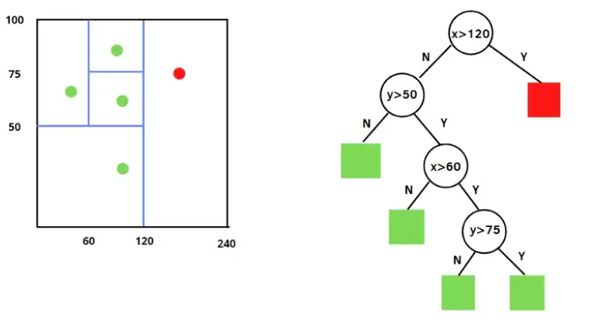
FIg 3.1 show examples of the procedure after four splits, respectively. In this case, I had only two features x and y and four
observations to check. The first condition is the one that distinguishes a normal observation from an anomaly. If x is bigger than 120, then the observation is an outlier and is colored in red.
Then, normal and anomalous data points can be distinguished based on average path length: shorter paths indicates that we have anomalies, while longer path shows that there are normal observations.

Slide 11
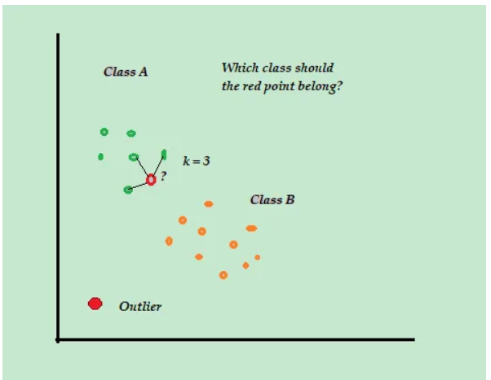
KNN :
Although kNN is a supervised ML algorithm, when it comes to anomaly detection it takes an unsupervised approach.
This is because there is no actual “learning” involved in the process and there is no pre-determined labeling of “outlier” or “not-outlier” in the dataset, instead, it is entirely based upon threshold values. Data scientists arbitrarily decide the cutoff values beyond which all observations are called anomalies.
That is also why there is no train-test-split of data or an accuracy report.

Slide 12
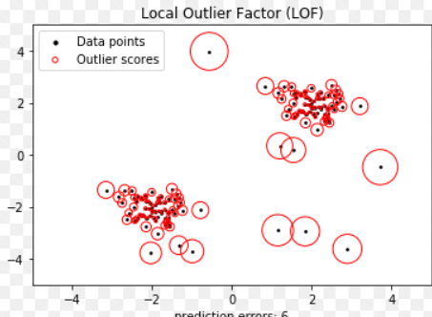
LOF
Local outlier factor (LOF) is an algorithm used for Unsupervised outlier detection.
It produces an anomaly score that represents data points which are outliers in the data set.
It does this by measuring the local density deviation of a given data point with respect to the data points near it. Working of LOF: Local density is determined by estimating distances between data points that are neighbors (k-nearest neighbors). So for each data point, local density can be calculated.
By comparing these we can check which data points have similar densities and which have a lesser density than its neighbors.
The ones with the lesser densities are considered as the outliers. Firstly, k-distances are distances between points that are calculated for each point to determine their k-nearest neighbors. The 2nd closest point is said to be the 2nd nearest neighbor to the point.

Slide 13
4. Tools used
Laptop with at least i5 processor and GPU for faster processing.
Operating System: Windows/ Linux/ Mac OS.
Visual studio IDE.
Pycaret: PyCaret is an open-source, low-code machine learning library in Python that automates machine learning workflows. It is an end-to-end machine learning and model management tool that exponentially speeds up the experiment cycle and makes you more productive.
Numpy: NumPy is a Python library used for working with arrays. It also has functions for working in domain of linear algebra, fourier transform, and matrices.
Seaborn: Seaborn is a library that uses Matplotlib underneath to plot graphs. It will be used to visualize random distributions.
Matplotlib: Matplotlib is a comprehensive library for creating static, animated, and interactive visualizations in Python. Matplotlib makes easy things easy and hard things possible.

Slide 14
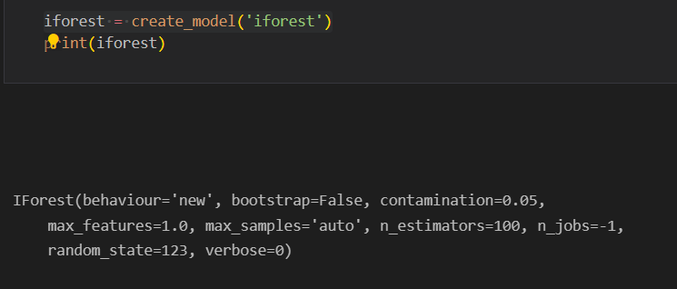

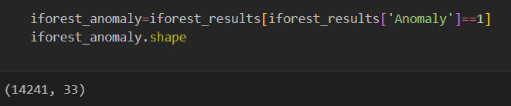
5. Modules implementation and results

Slide 15
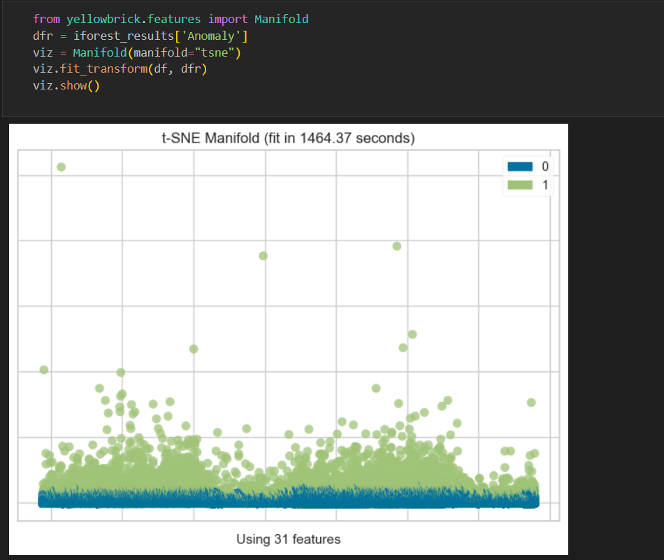
Detecting anomaly using iforest. Takes 30 secs to run and 20 mins to plot the graph.

Slide 16
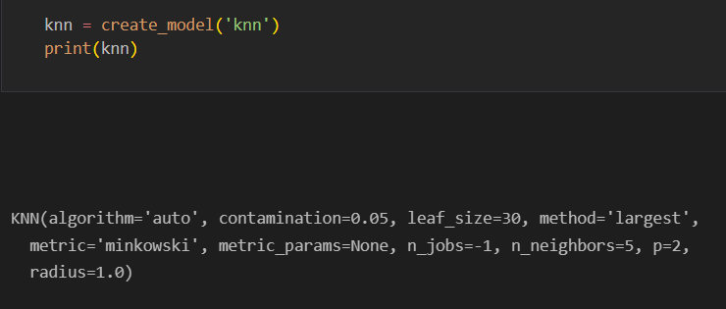
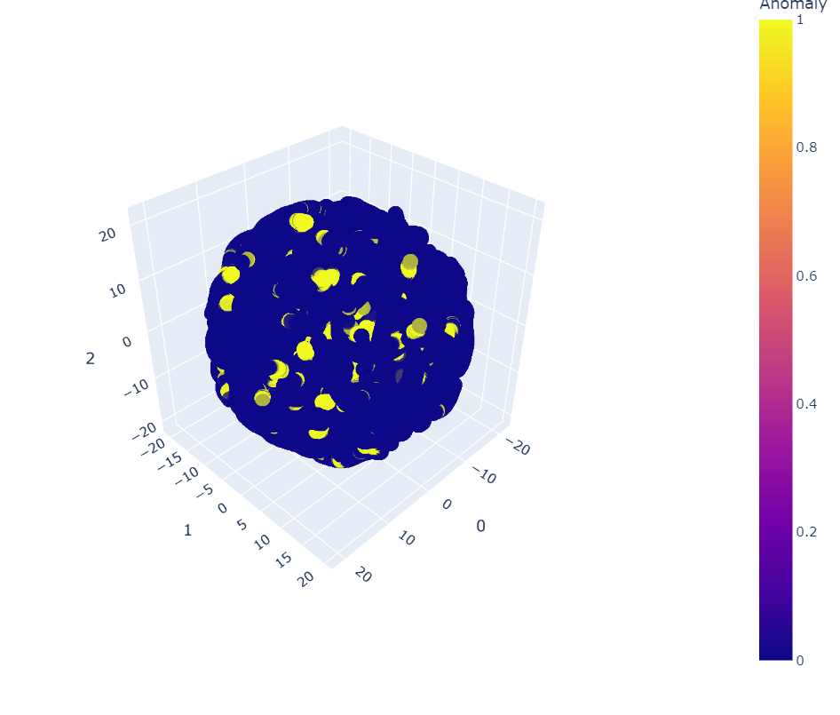
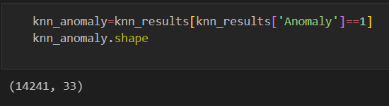
Anomaly detection using the knn model. Takes 30 mins to run and 40 mins to plot the graph.

Slide 17
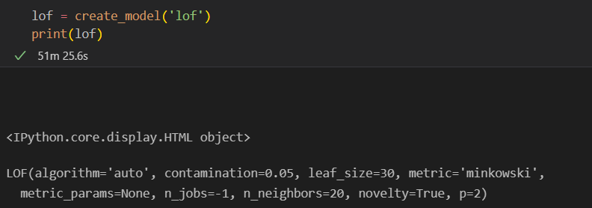
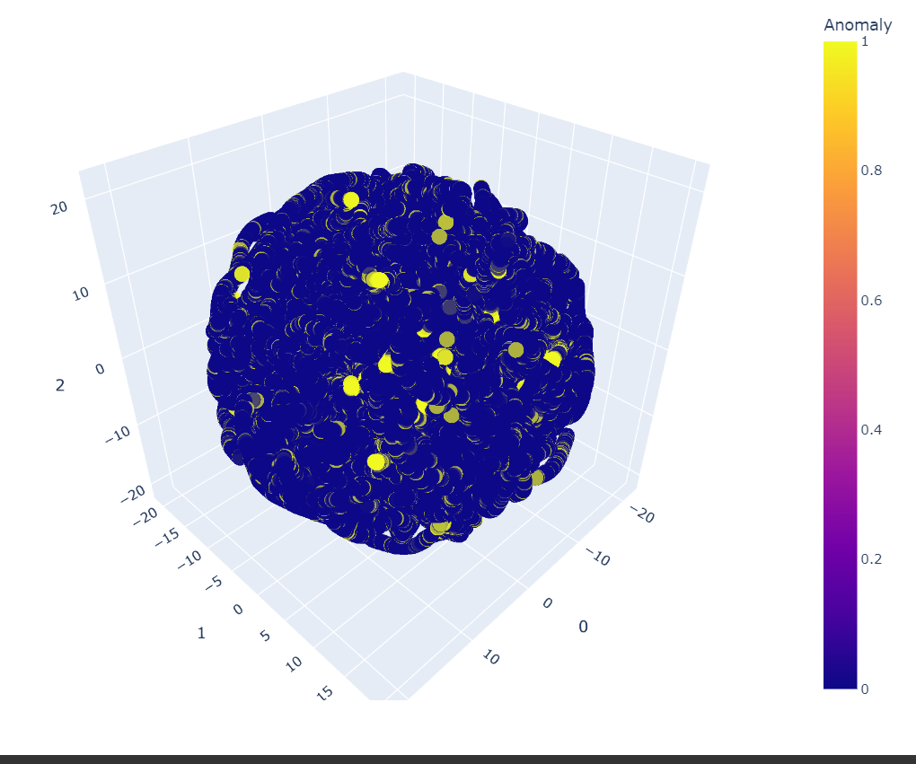
Anomaly detection using lof. Takes 45 mins to create a model and 60 mins to plot the graph

Slide 18
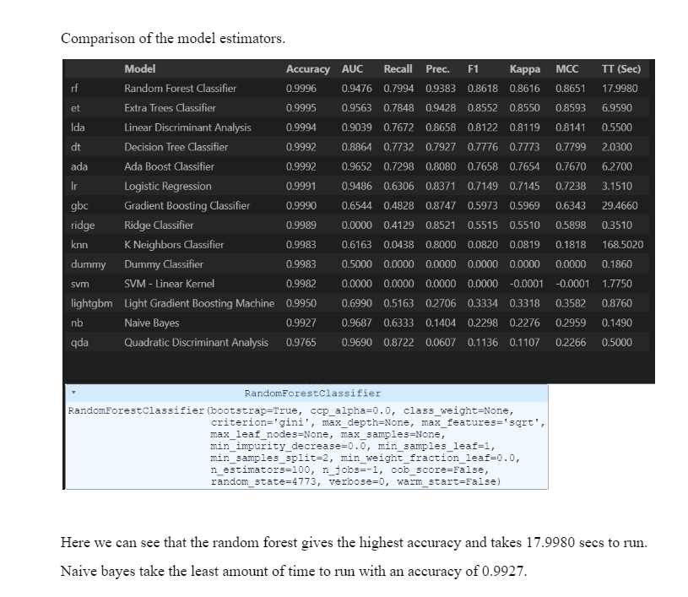

Slide 19
6. Learnings and Takeaways from the Study
Anomaly detection is a binary classification between the normal and the anomalous classes.
However, it is not possible to train a model with full supervision for this task because we frequently lack anomalous examples, and, what is more, anomalies can have unexpected patterns.
The anomaly detection techniques in the pycaret library can be used to compare the various models.
The various model like iforest, K nearest neighbor, local outliner factor were compared and iforest running time was the least which is 30 seconds, knn is 45 minutes and lof 60 minutes.
From this we can infer that iforest is the best model for predicting the anomalies.
On comparing the various model estimators it can be inferred that the random forest gives the highest accuracy and takes 17.9980 secs to run.
Naive bayes take the least amount of time to run with an accuracy of 0.9927.

Slide 20
References and Annexures
[1] Dwivedi, Asheesh Kumar. "Fraud Detection in Credit Card Transactions using Anomaly Detection." Turkish Journal of Computer and Mathematics Education (TURCOMAT) 12, no. 12 (2021): 837-846.
[2] Yu, Wen-Fang, and Na Wang. "Research on credit card fraud detection model based on distance sum." In 2009 International Joint Conference on Artificial Intelligence, pp. 353-356. IEEE, 2009.
[3]Sohony, Ishan, Rameshwar Pratap, and Ullas Nambiar. "Ensemble learning for credit card fraud detection." In Proceedings of the ACM India Joint International Conference on Data Science and Management of Data, pp. 289-294. 2018.
[4]Pang, Guansong, Chunhua Shen, Longbing Cao, and Anton Van Den Hengel. "Deep learning for anomaly detection: A review." ACM computing surveys (CSUR) 54, no. 2 (2021): 1-38.
[5]Liu, Fei Tony, Kai Ming Ting, and Zhi-Hua Zhou. "Isolation forest." In 2008 eighth ieee international conference on data mining, pp. 413-422. IEEE, 2008.
[6]Bandaragoda, Tharindu R., Kai Ming Ting, David Albrecht, Fei Tony Liu, Ye Zhu, and Jonathan R. Wells. "Isolation‐based anomaly detection using nearest‐neighbor ensembles." Computational Intelligence 34, no. 4 (2018): 968-998.
[7]Malini, N., and M. Pushpa. "Analysis on credit card fraud identification techniques based on KNN and outlier detection." In 2017 third international conference on advances in electrical, electronics, information, communication and bio-informatics (AEEICB), pp. 255-258. IEEE, 2017.
[8]Ounacer, Soumaya, Hicham Ait El Bour, Younes Oubrahim, Mohamed Yassine Ghoumari, and Mohamed Azzouazi. "Using Isolation Forest in anomaly detection: the case of credit card transactions." Periodicals of Engineering and Natural Sciences (PEN) 6, no. 2 (2018): 394-400.

